Slide 1
Predictive maintenance for machines
A machine Learning approach to predict machine failure

Slide 2
Business Understanding
Manufacturing industries rely heavily on equipment that must operate efficiently and continuously to meet production targets. Unplanned machine failures result in costly downtime, repair expenses, and lost productivity. Traditional maintenance strategies—either reactive (fix after failure) or preventive (scheduled maintenance)—often lead to inefficiencies, either by acting too late or too early.

Slide 3
GOALS
Develop a binary classification model to predict machine failure ( No Failure OR Failure).
Perform Exploratory Data Analysis (EDA) to uncover key drivers of failure.
Rank the importance of sensor features contributing to failure.
Build a real-time or batch scoring system for predictive alerts.

Slide 4
WHY IT MATTERS
Most companies currently experiences production losses due to unexpected machine failures. While sensor data is available, it is not being fully leveraged to predict when a failure is imminent.

Slide 5
DATA UNDERSTANDING
The dataset consists of 10,000 records and 10 columns, collected from manufacturing machines equipped with various sensors.
Important columns include:
Type of machine
Air temperature [K]
Process temperature [K]
Rotational speed [rpm]
Torque [Nm]
Tool wear [min]
Binary indicator of failure — 0 for no failure, 1 for failure.

Slide 6
DATA Preparation
The process involved:
Dropping of unnecessary columns such as product ID
Adding new features such as; temperature difference
Data preprocessing i.e label encoding and scaling of the features

Slide 7
EXPLORATORY DATA ANALYSIS
Univariate Analysis
Bi-variate Analysis
Multi-variate Analysis

Slide 8
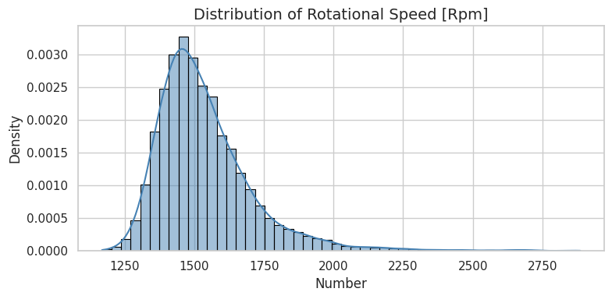
DISTRIBUTION OF ROTATION SPEED
The distribution is clearly right-skewed (positively skewed). This means the tail of the distribution extends further to the right.
The peak of the distribution, which represents the most frequent rotational speeds, appears to be around 1450-1500 RPM.

Slide 9
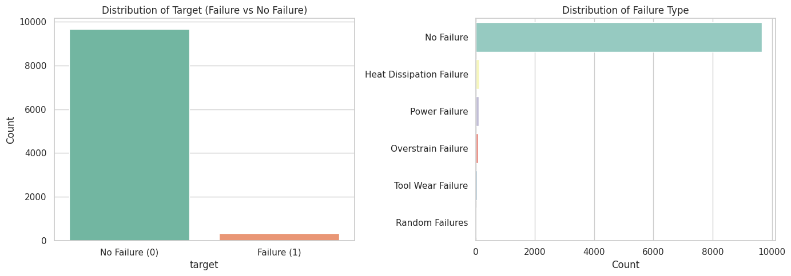
DISTRIBUTION OF THE TARGET
The 'Distribution of Target' plot shows a significant class imbalance. The number of instances with 'No Failure' (0) is much higher than those with 'Failure' (1).

Slide 10
MODELING
For the modeling part build FOUR traditional models that are good with classification. These models are:
Logistic Regression
Random Forest Classifier
XGBoost
Support Vector Machine
For the deep learning models tried out Artificial Neural Network (ANN)
The best performing models were the Random Forest and XGBoost which was ensembled and performed much better

Slide 11
EVALUATION
MODEL | ACCURACY | F1-SCORE
ENSEMBLE MODEL | 99% | 91%
RANDOM FOREST | 99% | 91%
XGBOOST | 99% | 90%
SUPPORT VECTOR MACHINE | 98% | 83%
LOGISTIC REGRESSION | 87% | 60%
NEURAL NETWORK | 98% | 81%

Slide 12
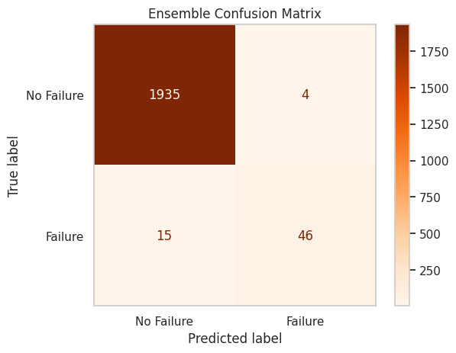
ENSEMBLE MODEL CONFUSION MATRIX
True Negatives (No Failure correctly predicted as No Failure): 1935 instances.
This is the highest number of correctly predicted "No Failure" instances among all models reviewed. T- rue Positives (Failure correctly predicted as Failure): 46 instances.
False Positives (No Failure incorrectly predicted as Failure): 4 instances. This is the lowest number of false positives among all models reviewed, indicating very few instances where "No Failure" was wrongly flagged as "Failure."
False Negatives (Failure incorrectly predicted as No Failure): 15 instances. This is tied with the Random Forest model for the lowest number of false negatives, meaning it missed fewer actual "Failure" events.

Slide 13
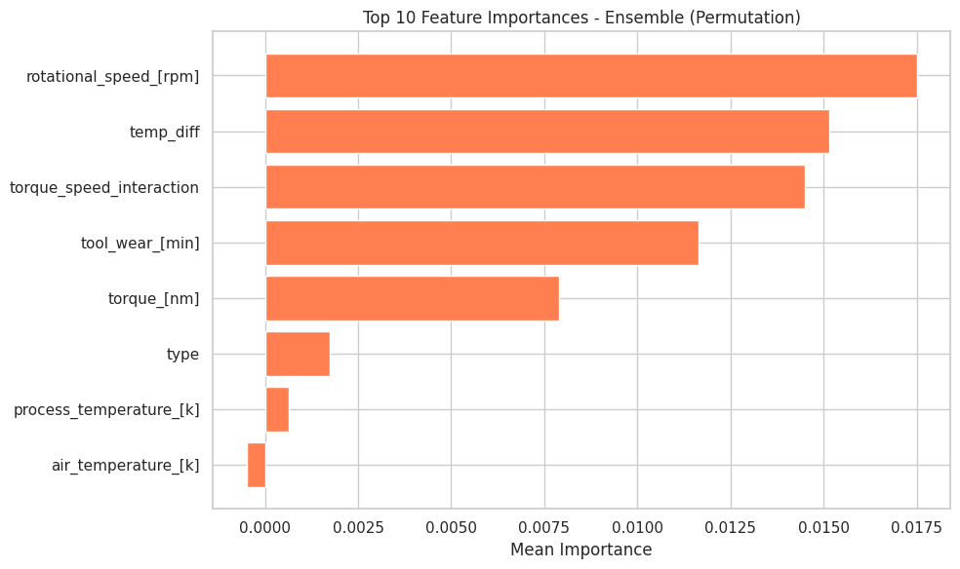
Feature importance graph
Dominant Features:
rotational_speed_[rpm] is by far the most important feature, with the highest mean importance value (around 0.0175).
temp_diff and torque_speed_interaction are also highly important, following rotational_speed_[rpm] closely.
tool_wear_[min] and torque_[nm] are the next most important features, though with a noticeable drop in importance compared to the top three.

Slide 14
CONCLUSION
Ensemble Model Outperforms Neural Network The ensemble model delivered superior performance across key metrics, especially for the minority class (failure).
There was effective Failure Detection with Fewer Errors
Neural Network Struggles with Class Imbalance

Slide 15
RECOMMENDATIONS
Adopt the Ensemble Model for Deployment
Monitor for Model Drift
Implement Model Explainability

